Slide 1
Business Data Management Capstone Project
Optimising the Sales of a Medium-Scale Grocery Shop
Name: Anish Kumar Pal
Roll No.: 22f1001091
Email: 22f1001091@ds.study.iitm.ac.in

Slide 2
Contents
Executive Summary: Introduction to Business
Data Collection and Cleaning
Data Analysis: Analysis Done in respect to the challenges
Findings
Recommendation

Slide 3
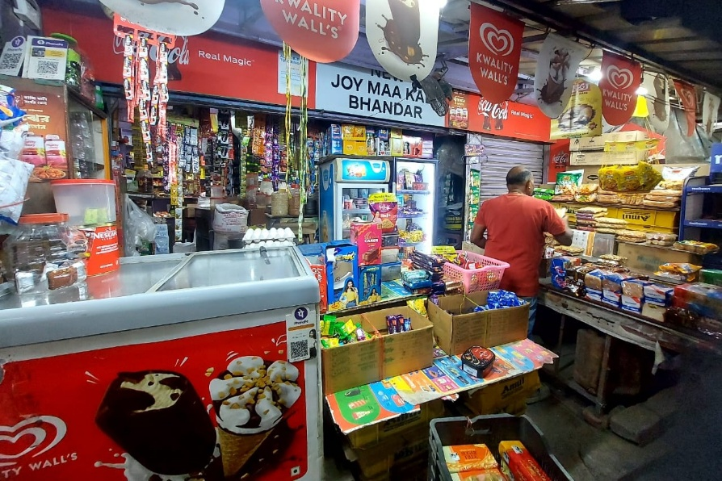
Executive Summary
The establishment under consideration is a moderate-sized general-purpose departmental store, New Joy Maa Kali Bhandar Shop established by Mr. Bipro Roy in the initial months of 2011.
The store primarily deals in a diverse range of products, including cereals, grains, pulses, oils, milk, and dairy items.
Regrettably, the business has been grappling with difficulties related to its financial performance, sales figures, and the effective management of inventory.

Slide 4
Data Collection and Cleaning
In the process of gathering data, I visited the store on a daily basis for a period of 31 days. During each visit, I meticulously recorded the sales figures, purchase quantities, prices, and inventory levels for a set of 10 specific items.
The dataset gathered for analysis constituted primary data and remained in its raw form.
Consequently, to refine and organize the information, Google Sheets/Excel was employed for data cleaning and to facilitate future analysis.

Slide 5
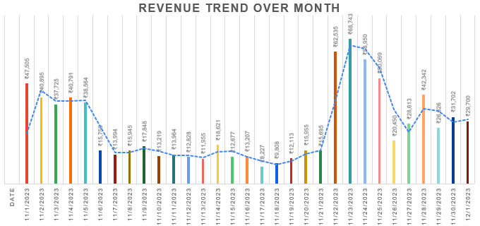
Data Analysis: Sales
Average Daily Revenue: ₹ 27,323
Deviation: 17118.80
Minimum Revenue: ₹ 8,227
Maximum Revenue: ₹ 68,743
Highest Revenue Generating Days: 22/11/2023 to 28/11/2023

Slide 6
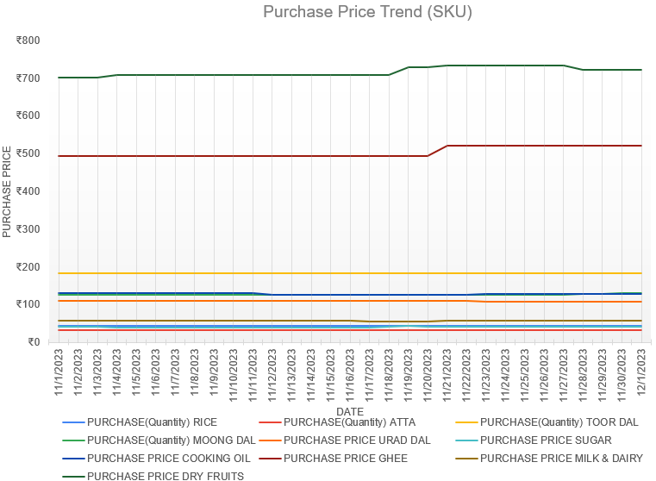
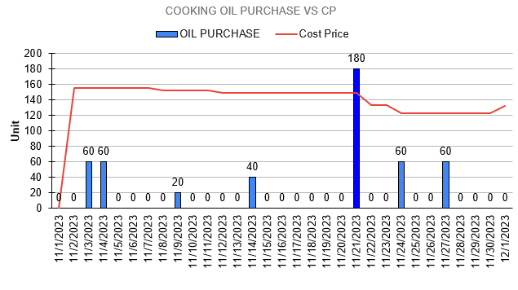
Data Analysis: Purchase
There appears to be a slight uptick in the purchase prices of most SKUs around the middle of the month, with the exception of the following observations: The purchase price of cooking oil tends to exhibit a decline.
In contrast, there is a notable surge in the purchase price of Urad Dal during this period.

Slide 7
Data Analysis: Profit/Loss
Enhancing the sales volume of Dry Fruits (1.1%) and Ghee (2.1%) is imperative for the store to augment its net profit.

Slide 8
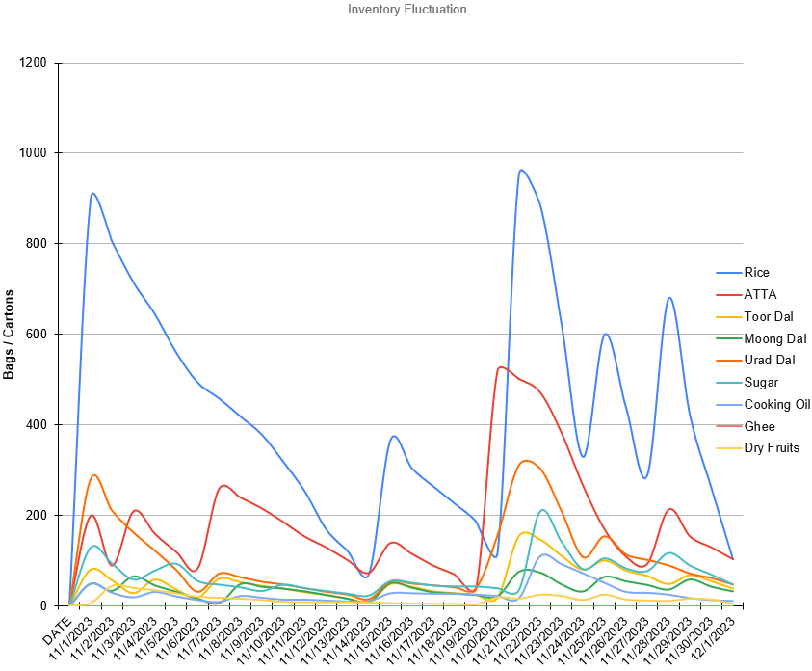
Data Analysis: Inventory
While the average stock aligns with sales patterns, notable fluctuations or variances are evident in the inventory levels for each SKU.

Slide 9
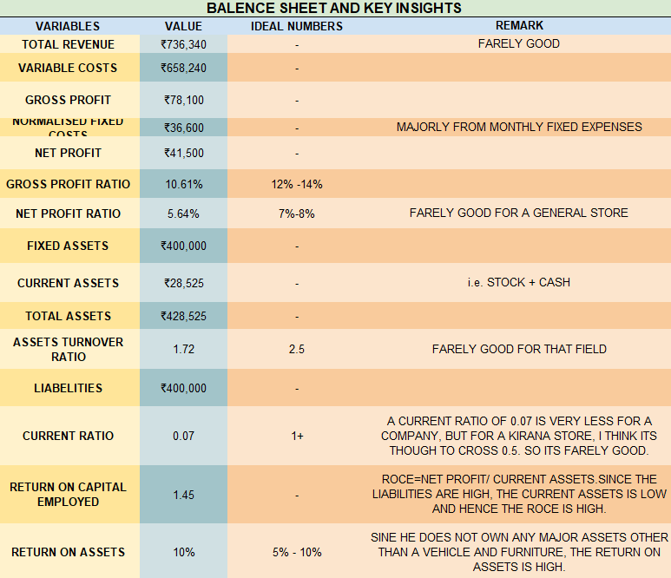
Findings

Slide 10
Final Recommendations
Maximize Profitable Sales:
Focus on high-profit items like Dry Fruits and Ghee.
Boost Milk Sales:
Actively work towards increasing Milk sales for revenue growth.
Optimize Inventory Restocking:
Replenish inventory earlier or during peak sales periods for improved customer satisfaction.
Enhance Financial Health:
Increase the current ratio through strategic inventory management and pricing.
Strategic Pricing:
Implement effective pricing strategies to maximize revenue.
Visual Merchandising:
Enhance store displays for increased customer engagement and sales impact.

